Slide 1

Objects & Web API

Slide 2
Primitive
string
number
boolean
null
undefined

Slide 3
Arrays
Let value =[4,53,2,5];

Slide 4
Arrays + Datatypes
let a =[3,'SKCET',4.3];
console.log((a))

Slide 5
De-structuring
let values=[4,45,23,231];
let [a,b,c]=values;
console.log(c);

Slide 6
Objects -Syntax
object={property1:value1,property2:value2.....propertyN:valueN}
let box ={color: "red",brand:"ABC", weight:10 }
Creates empty JavaScript object, and then add properties
Key value pair

Slide 7
Object inside Object
let person ={name:"ABC",
age : 20,
laptop :{
brand:"thinkpad",
ram:8,
color:"black"
}
}

Slide 8
Swaping
a =5;
b= 6;
console.log(a);
console.log(b);
[a,b]=[b,a]
console.log(a);
console.log(b);

Slide 9
Rest Operator
let values =[3,23,2,22,22,22];
[a,b,...c]=values;
console.log(a);
console.log(b);
console.log(c);

Slide 10
Rest and Spread Operator
…

Slide 11
Rest
function sum(a,b,...c){
let sum = a+b;
for(let i=0;i<c.length;i++)
sum+=c[i];
return sum;
}
console.log(sum(5,6,7,8,9));

Slide 12
Spread Operator
function sum(a,b)
{
let n =a+b;
return n;
}
let a=[4,4];
console.log(sum(...a));

Slide 13
this keyword
let user = {
firstname:"ABC",
lastName:"ZYX",
getFullName: function(){
return this.firstname+this.lastName;
}
}
console.log(user.getFullName());

Slide 14
Call
let user = {
firstname:"ABC",
lastName:"ZYX",
getFullName: function(){
return this.firstname+this.lastName;
}
}
let user2 = {
firstname:"MNOP",
lastName:"QRST",
}
console.log(user.getFullName.call(user2));

Slide 15
Call
let user = {
firstname:"ABC",
lastName:"ZYX",
getFullName: function(text){
return this.firstname+this.lastName+text;
}
}
let user2 = {
firstname:"MNOP",
lastName:"QRST",
}
console.log(user.getFullName.call(user2,'mam'));

Slide 16
Apply
let user = {
firstname:"ABC",
lastName:"ZYX",
getFullName: function(text){
return this.firstname+this.lastName+text;
}
}
let user2 = {
firstname:"MNOP",
lastName:"QRST",
}
console.log(user.getFullName.apply(user2,['mam']));

Slide 17
bind
let user = {
firstname:"ABC",
lastName:"ZYX",
getFullName: function(){
return this.firstname+this.lastName;
}
}
let user2 = {
firstname:"MNOP",
lastName:"QRST",
}
let x=user.getFullName.bind(user2);
console.log(x());

Slide 18
Web API - Objective
Create a simple HTML page to display the temperature using the OpenWeather API

Slide 19
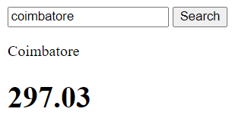
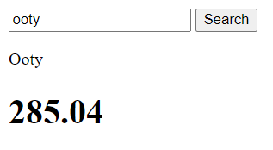
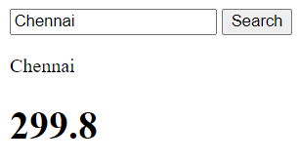
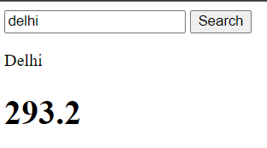
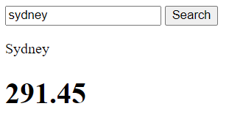
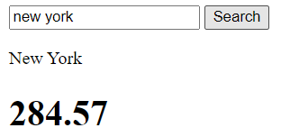
Web API

Slide 20
Steps
Create account in openweathermap and get your API key
Get the URL to make API call for current weather data
Change the city name and API key in the URL
See the result in JSON format
Display the result with simple html and Javascript file

Slide 21
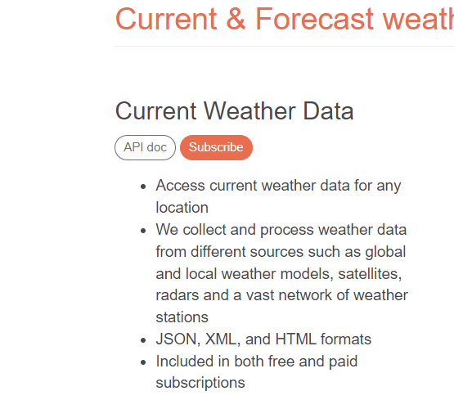
Sign up -OpenWeather API
https://openweathermap.org/api
Sign up
Get the API key for “Current Weather Data”

Slide 22
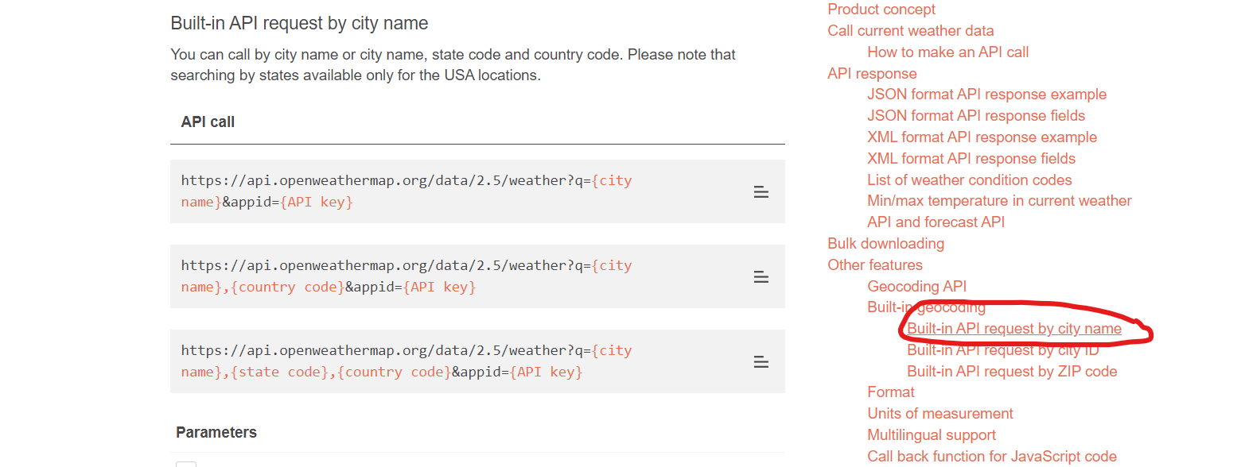
Get the API URL for City based search

Slide 23
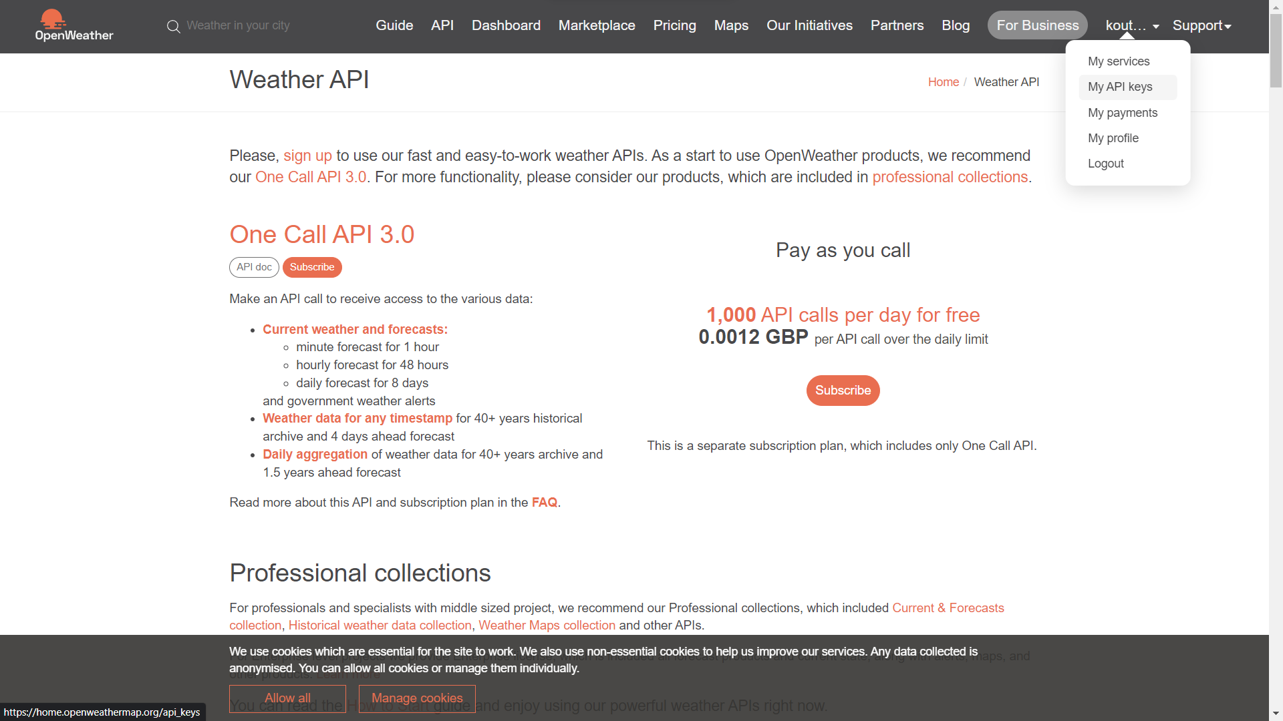
Get your API key

Slide 24
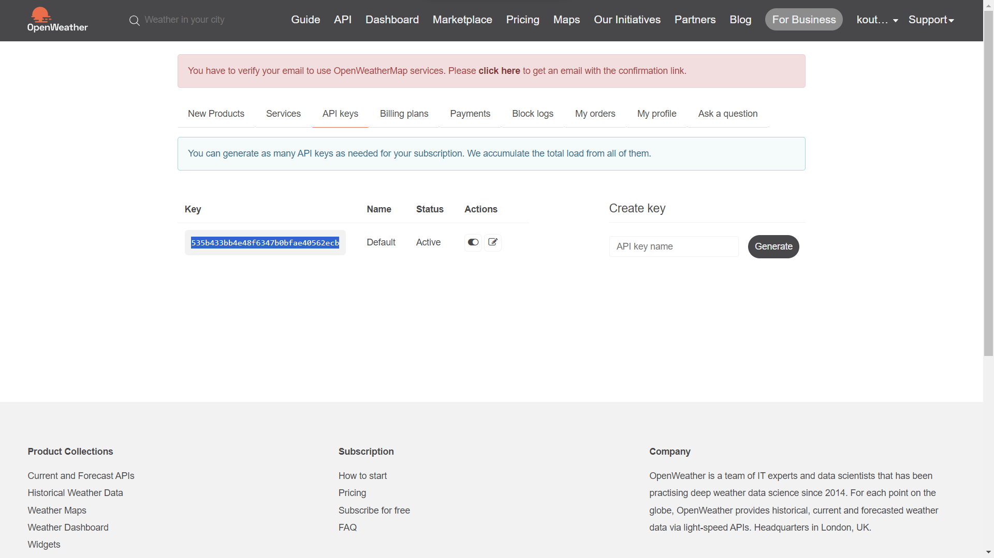
Copy the API Key

Slide 25
JSON Data
https://api.openweathermap.org/data/2.5/weather?q={city name}&appid={API key}
https://api.openweathermap.org/data/2.5/weather?q=ooty&appid=535b433bb4e48f6347b0bfae40562ecb
Note : Replace the city name and api key(your api key)

Slide 26
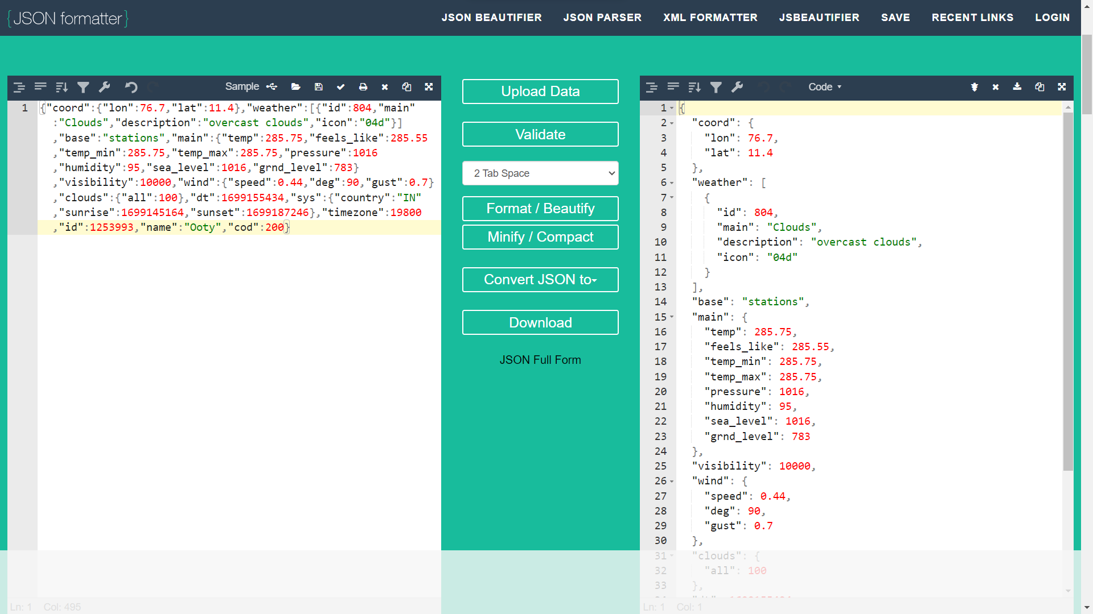
JSON formatter

Slide 27
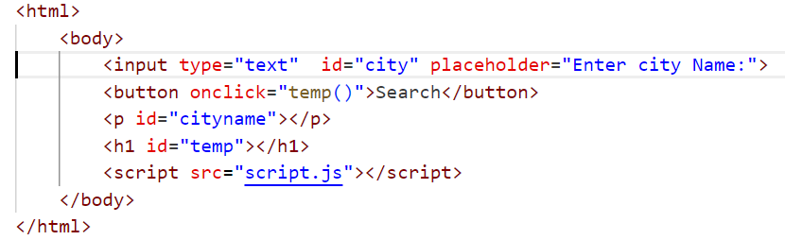
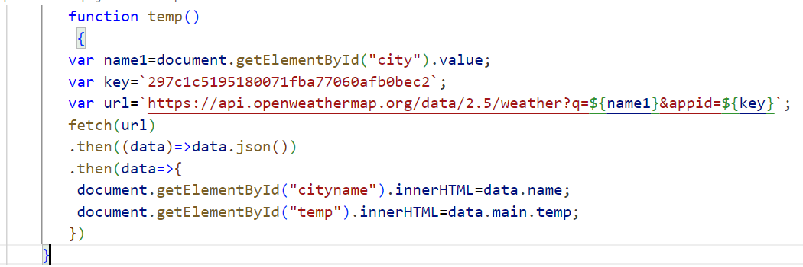
Html and JS file – Replace with your API details

